Slide 1














Future projection of climate at Dhaka city of Bangladesh
Presented by
Shoeb Akter
DS-02

Slide 2

Introduction
By 2050, the world’s population is expected to reach 9.6 billion, with around 66% living in urban areas . This shift is happening rapidly, particularly in developing countries where the majority of people have been living in cities since 2017 . Urban growth, driven by migration from rural to urban areas, has created dense, overburdened cities that are especially vulnerable to the impacts of climate change. In cities with limited infrastructure and management capacity, these risks are compounded, making adaptation essential for protecting urban populations. Without effective adaptation strategies, people in developing countries are expected to face even greater climate challenges in the future.
.

Slide 3
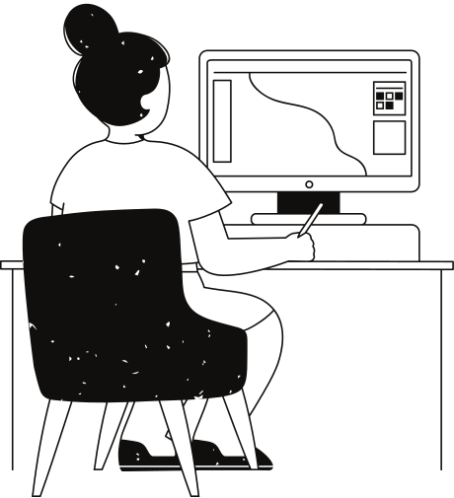
Tools Utilized
NumPy
Building on the power of Python, I utilized NumPy to handle numerical calculations efficiently. NumPy is renowned for its ability to perform array-based operations, allowing for fast and efficient processing of large datasets.. Its ability to perform complex mathematical computations with ease significantly sped up the analytical process, enabling deeper insights into the data.
Pandas
For data manipulation, Pandas was my go-to library. It transformed the way I worked with the seismic dataset by providing powerful data structures, specifically DataFrames, which are ideal for handling tabular data. With Pandas, I could effortlessly load the dataset, clean it by addressing missing values, and reorganize it to prepare for analysis. The library's intuitive functions made it easy to filter data, group it by specific attributes, and perform operations that would have been cumbersome with basic Python alone.
Matplotlib
To visualize the patterns and trends emerging from the dataset, I turned to Matplotlib, one of the most widely used libraries for data visualization in Python. Matplotlib allowed me to create a variety of static, animated, and interactive plots, bringing the data to life in a visual format. I used it to generate basic plots that illustrated key findings, such as frequency distributions of the temperature and rainfall.

Slide 4
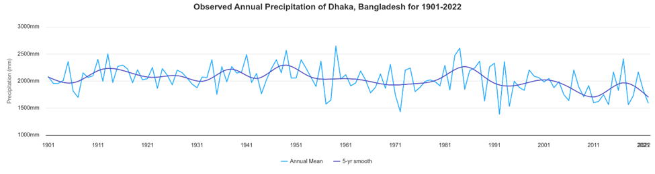
Statistical Downscaling Model

Slide 5
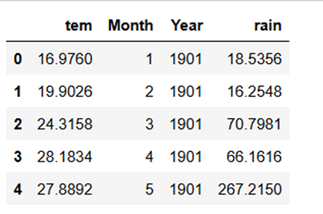
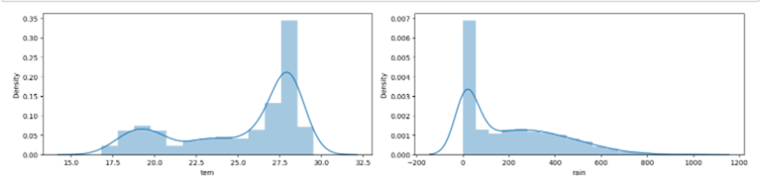
Data Processing
Check which column of the dataset contains which type of data:

Slide 6
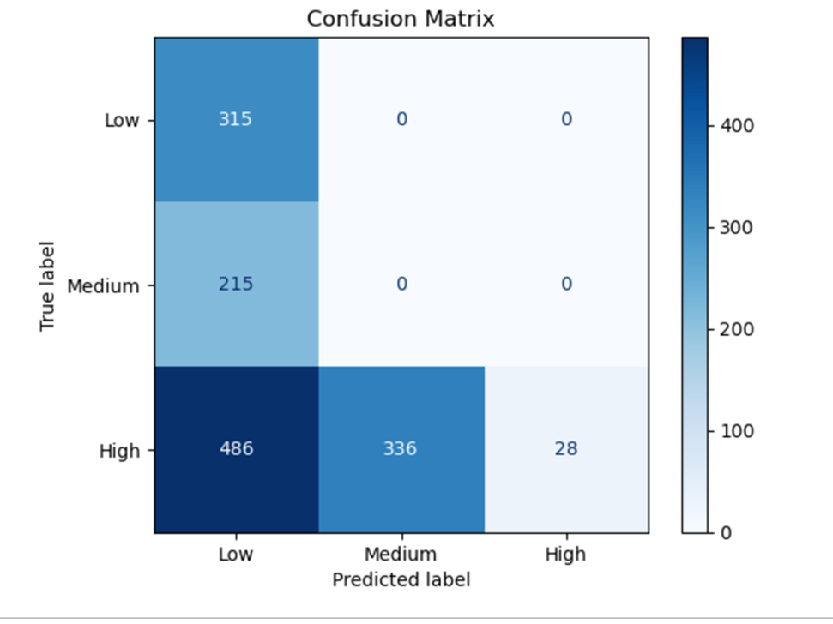

confusing matrix use

Slide 7
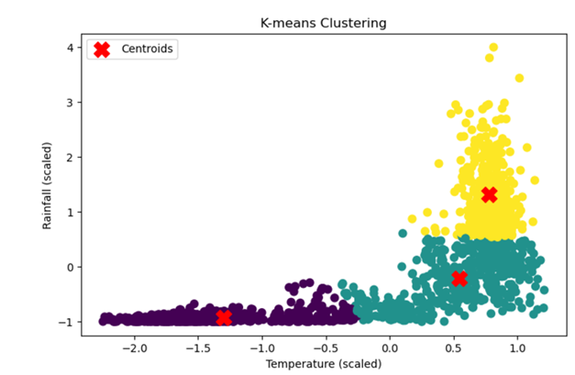
K-means clustering value

Slide 8
CONCLUSION
Historical rainfall and temperature data of Dhaka city was analyzed to assess the recent changes in the climate of Dhaka. SDSM was also used to downscale future projections of climate at Dhaka city. The study revealed that the climate change would cause continuous increase of rainfall, temperature and weather related extreme events in Dhaka. However, the most imminent impacts of climate change in Dhaka will be due to the rise of temperature and related extremes, such as, frequent outbreak of tropical diseases, scarcity of water, increased demand of power, etc. It is necessary to incorporate climate change adaptation guidelines into all planning, design, construction, operation and maintenance of urban infrastructure of Dhaka city. It is expected that the finding of present study will help to enhance the knowledge on ongoing changes in the climate and climate related extreme events, possible future scenarios of climate, impacts of climate change on different sectors of Dhaka city according to their certainty and timing. It will also help to identify the possible adaptation measures to mitigate the negative impacts of climate change in Dhaka, which is the political and financial center of the country. Appropriate strategies based on the climate information presented in this paper will reduce the vulnerability of urban livelihoods and infrastructures to future climate change and contributes to achieve sustainability in resources.

Slide 9
Thank you very much!

